Slide 1

Telco Churn Prediction Milestone 1
By : Muhammad Julizar

Slide 2

Background
Today we are in a period where the internet seems to be the primary need of human beings because it fills almost the entire space of our lives.
So, i want to make best model to predict which customers have left or stayed in telco company.
dataset is from telco company that provided home phone and Internet services to around 7000 customers in California in Q3.

Slide 3
Objective
Make the best Model to predict Churn customer from Telco Company

Slide 4
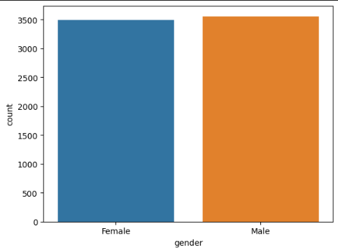
EDA
The number of customers by gender
Is almost have no difference between
male and female
Notes:
Telco company dataset

Slide 5
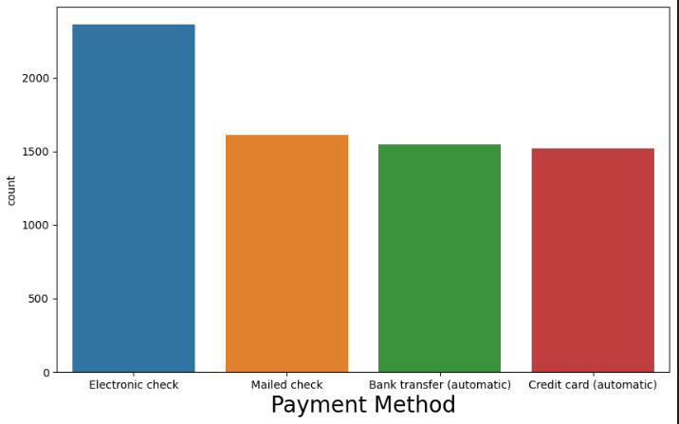
EDA
There are 4 payment methods from telco company
Notes:
With Electronic Check being the most used method.
Followed by …..

Slide 6
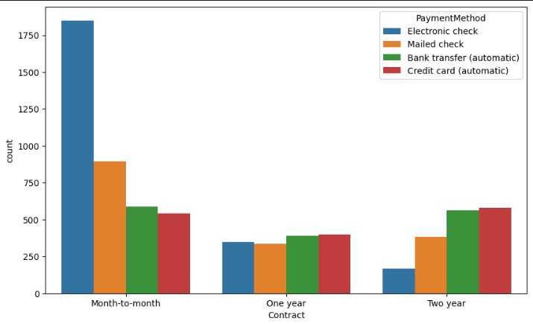
EDA
If we look at the type of contract, it turns out that month-to-month is the most used contract.
with Electronic Check is the payment method that commonly used by customers
Notes:
long-term contracts, the payment method that is often used is credit card automatic

Slide 7
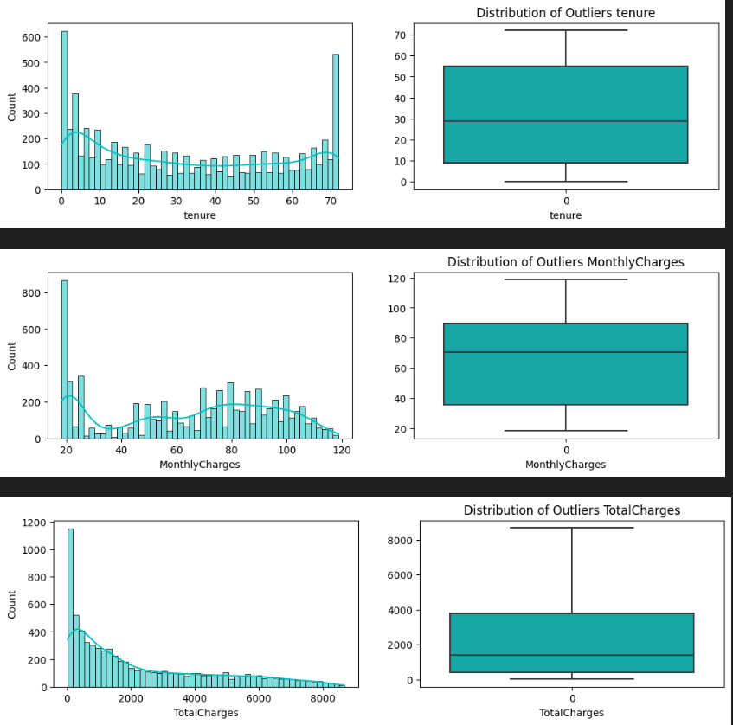
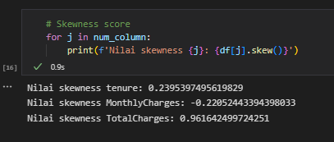
EDA
In the data distribution from Numeric features
Notes:
It proven from the Skewness Value on Totalcharges is 0.96

Slide 8
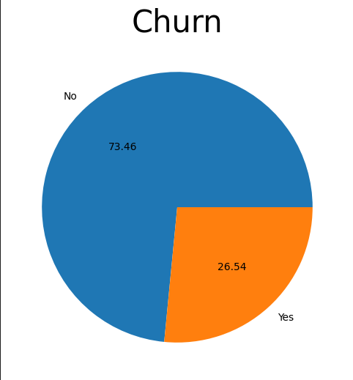
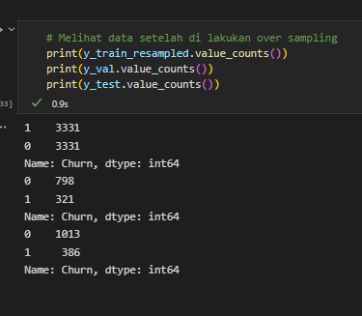
EDA
Churn column is the target of its model, it look so imbalanced with 73.46% No and 26.54% Yes.
So I use smote technique to make balanced and make the model easily to train
Notes:
So I use smote technique to make balanced and make the model easily to train

Slide 9
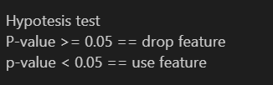
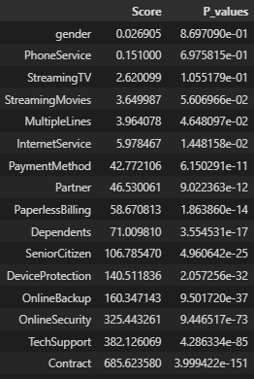

Preprocessing
Hypotesis Test
2
CHI
ANOVA
From 16 features it become 12 features
All features have a lower P-Value than 0.05

Slide 10
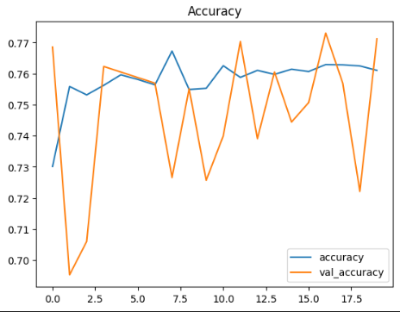
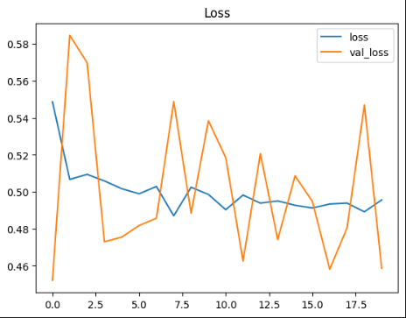
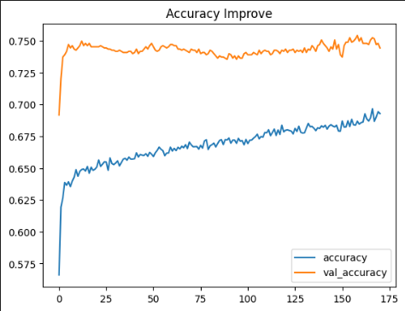
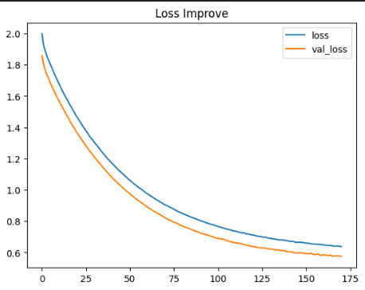
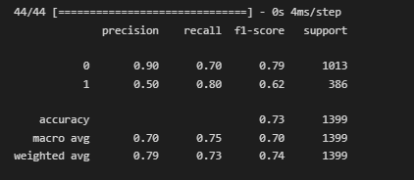
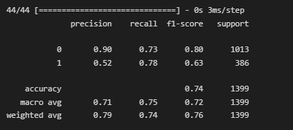
Model Sequential
So, in this model I use some optimization technique to eliminate GRADIENT EXPLODING problem
Base sequential model problem GRADIENT EXPLODING
Notes:
Optimization technique : activation function, kernel regulazier and initializer, batch norm, drop out
And on the model compile I use Gradient clipping
Result is success

Slide 11
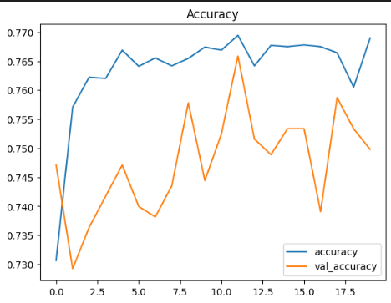
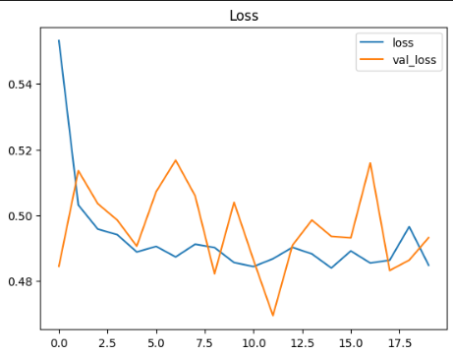
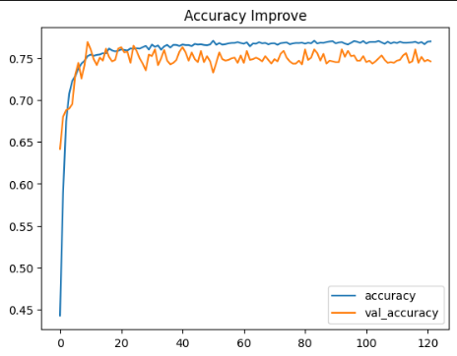
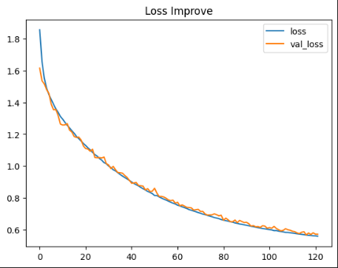
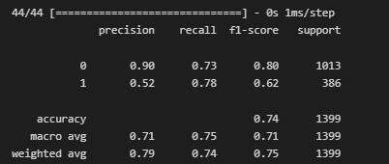
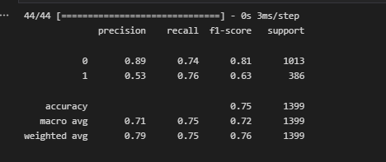
Model Functional
Same problem GRADIENT EXPLODING
Same technique with sequential model

Slide 12
CONCLUSION
After feature selection of 20 features it’s used only 15 features
Despite the overfitting of the sequential model, the improvements of both models look successful
In the target from Val set and Test was imbalanced that is impacted on the model, so it can make the model very hard to predict, especially class 1
The best Model for Churn Prediction is Functional Model Improvement

